Slide 1
Capabilities, Limitations, and Requirements of the StarCraft II Learning Environment (SC2LE)
Using StarCraft II for
AI Research
Systems Engineering and Operations Research Department, Volgenau School of Engineering
Aston E. Harvey
Ashton.e.Harvey@gmail.com
PhD Student in SEOR

Slide 2
Agenda
What is StarCraft II (SC2)
Overview of SC2
Examples of Gameplay
Why SC2
SC2LE & PySC2
Reward Structures
Observations
Actions
Minigames
raw API
Performance
Links
3-16
3-12
12-16
17
18-19
20
21-22
23-24
25
26
27
28

Slide 3
What is StarCraft II (SC2)
SC2 is a top down view real-time strategy game (continuous time)
Contains 3 Asymmetric factions
Each player plays as one faction
The simplistic typical multi-player game is a one on one total defeat game
Each player starts with a limited quantity of resources in stock, a base next to strategic resource deposits, and a number of their faction’s basic logistical units
Players must formulate a strategy that balances logistical and force generation requirements
The logistical requirements of many units force the construction of signature buildings presenting indications of a players strategy
Many unit types can be hard countered by specific other unit types, thus players with additional battlefield awareness have a tactical edge in implementing counterforce strategies

Slide 4
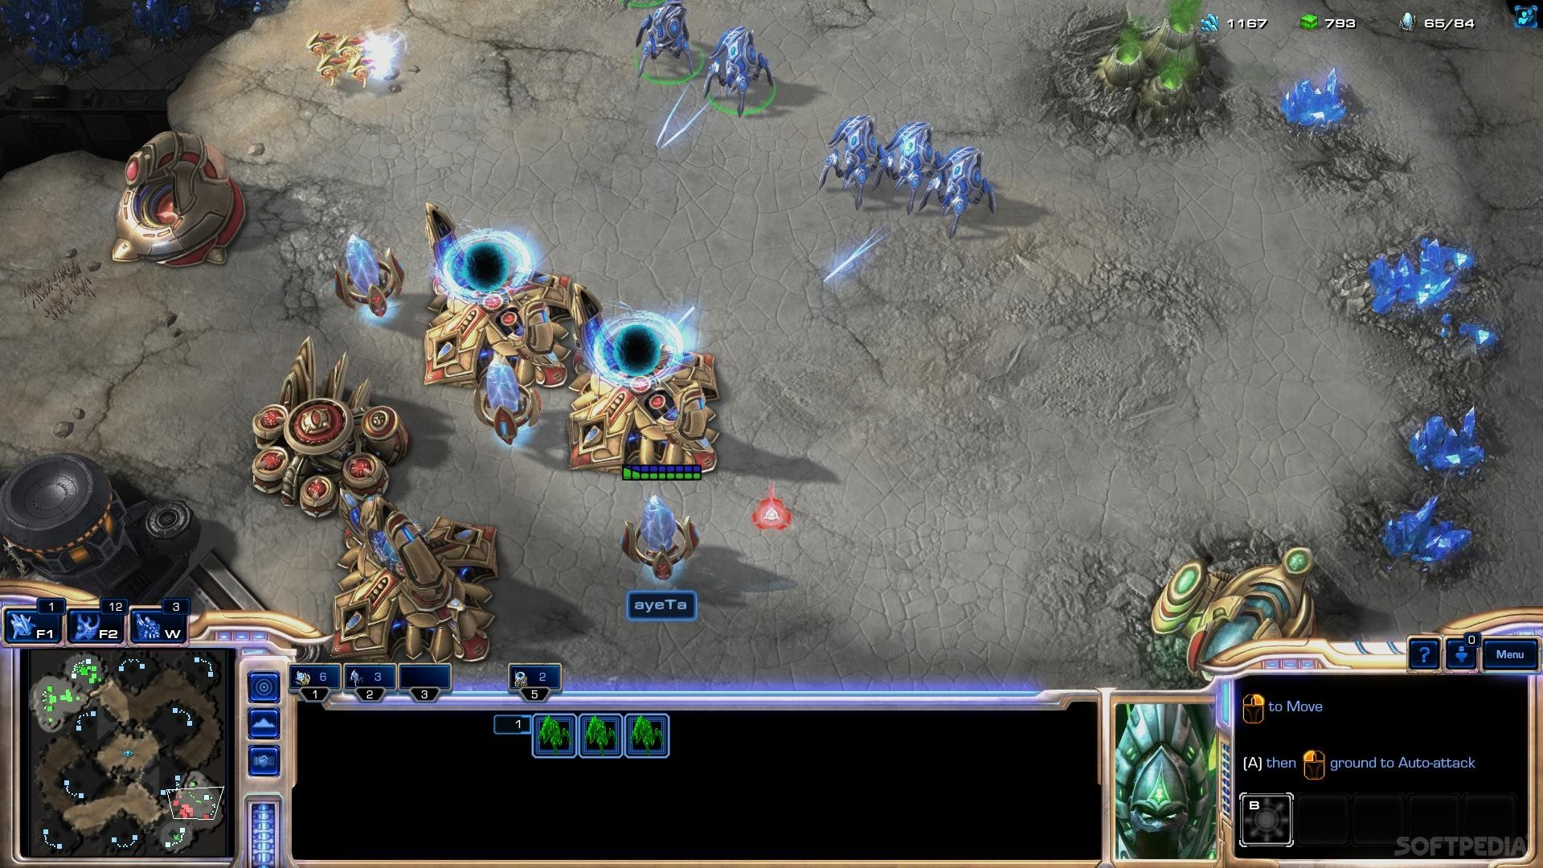
What is SC2 – Will revisit again

Slide 5
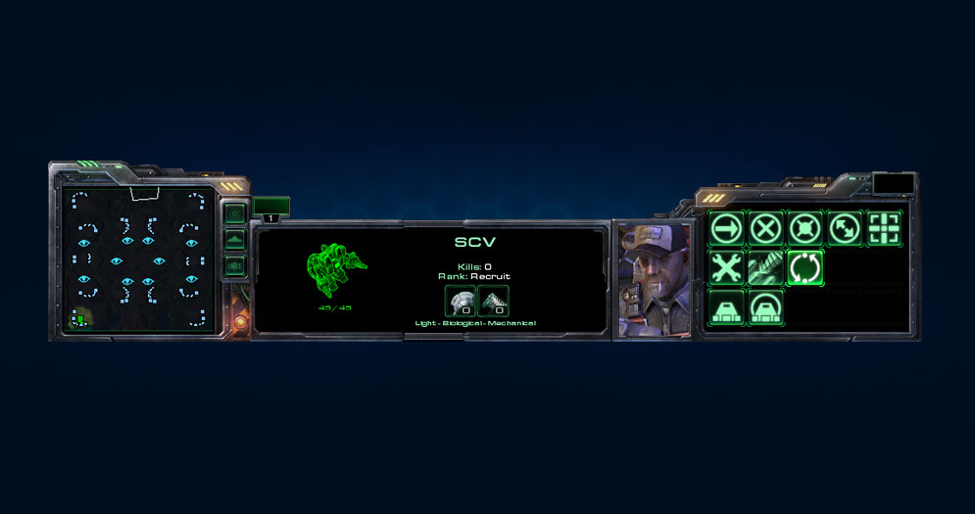
UI OVERVIEW
The main interface bar at the bottom of the screen is divided into three sections:
MINIMAP
The minimap on the left shows units, structures, terrain, resource deposits, and special buildings.
INFORMATION PANEL
The information panel in the center displays useful data about the currently selected units or structures, like hit points, armor, and a graphic representation showing its current condition.
COMMAND PANEL
The command panel on the right lets you issue commands like move, build, patrol, and attack.

Slide 6
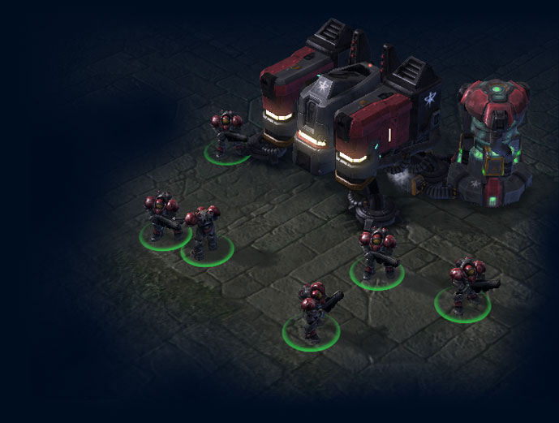
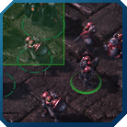
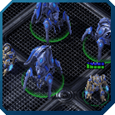

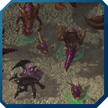
SELECTING UNITS AND BUILDINGS
To issue commands to a unit or a building, you must first select it. The most basic way to select a unit is to left-click the unit on the screen. However, there are other ways to select units that may come in handy.
DRAG SELECTION
Click and hold the left mouse button, then drag the mouse to draw a box. Every unit within that box will be selected. Buildings cannot be selected by drag selection.
CONTROL SELECTION
Hold down the Ctrl key and left-click a unit to select all units of the same unit type (e.g., all Marines, or all Siege Tanks) with one click. Double-clicking a unit has the same effect.
GROUP SELECTION
You can press Ctrl+1 through 0 to save your current selection of units and assign them to a control group. Pressing 1 through 0, you can quickly recall that selection. Double-pressing the number will center your view of the battlefield on the current group. For example, if you have two strike forces on the field; you could select one of them and assign them to group 1, and the other to group 2. This would allow you to quickly jump back and forth between the two groups without wasting time re-selecting them manually.
SHIFT SELECTION
Shift-clicking a unit will add that unit to your selection. Drag and shift selection can be combined, which allows you to create varied groups quickly.

Slide 7
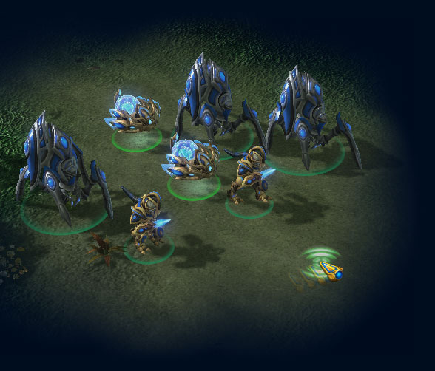
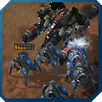
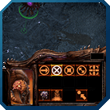
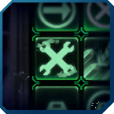
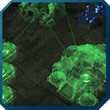
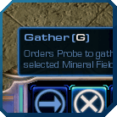
ISSUING COMMANDS
Once you’ve selected a unit or building, you can start giving it orders. Again there is a basic way to do this, and several more advanced ones.
RIGHT CLICK
Right-clicking will issue a context-sensitive command to your currently selected units. For example, if you right-click the terrain, your units will attempt to move to where you clicked; right-clicking an enemy will make your units try to attack that enemy.
COMMAND PANEL
All available commands for your current selection are shown at the bottom right-hand side of the screen in the command panel. The commands shown here can be issued by left-clicking them. Some commands, like the “move” command, require a target. In that case, left-click the command, then left-click the target
AUTOCAST
Some units have special abilities which can be set to “autocast” by right-clicking the ability’s icon in the command panel. Autocasting means that the unit will use their ability automatically when appropriate. For example, if you can set an SCV’s repair ability to autocast, it will attempt to repair any damaged buildings near it automatically.
QUEUING COMMANDS
Hold down the Shift key to queue up commands. For example, you can use this to quickly order an SCV to build a series of Supply Depots instead of having to re-select the unit and re-order a new Supply Depot each time, or you can queue move orders to make your units follow a specific route across the battlefield.
HOTKEYS
The most efficient way to issue commands is via hotkeys. If you mouse over the command panel’s icons, you will see that each command is associated with a hotkey. Pressing the hotkey is identical to clicking the control panel, but much faster. Learning the hotkeys is important if you want to play as efficiently as possible.

Slide 8
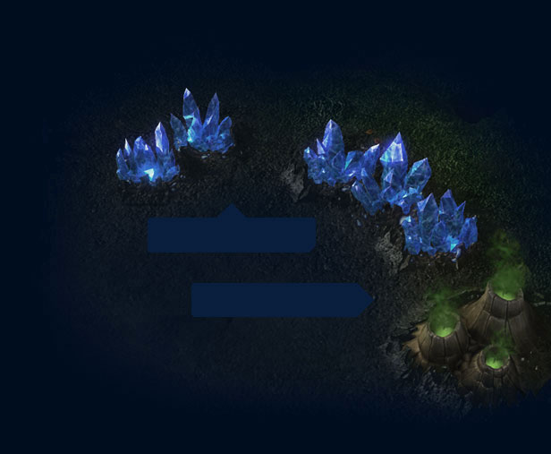
RESOURCES
Building an army is expensive, so you will have to send out workers to gather resources to feed your hungry war machine. There are two types of resources you can gather: minerals and vespene gas. As your workers (SCVs for the terrans, probes for the protoss, and drones for the zerg) gather resources, your total resource count will go up; expanding your base, growing your army, research, and certain abilities will consume resources and make your total go down. Resource management and knowing when and where to spend your income is one of the most important aspects of StarCraft II.
MINERAL CLUSTER
VESPENE GEYSER

Slide 9



SUPPLY
Your base’s infrastructure places a limit on the maximum size of your army; in other words, if you want to field a large force, you will have to raise your supply cap by investing some resources into measures that will let you support a bigger army. Each race has its own unique way of raising the supply cap:
TERRAN
SUPPLY DEPOT
Terran supply depots provide the logistical backbone for a large army.
PROTOSS
PYLON
Protoss advanced deployment technologies require pylons to expand operations.
ZERG
OVERLORD
Zerg swarms cannot grow beyond a certain threshold without the overlords’ ability to telepathically keep units in line.

Slide 10
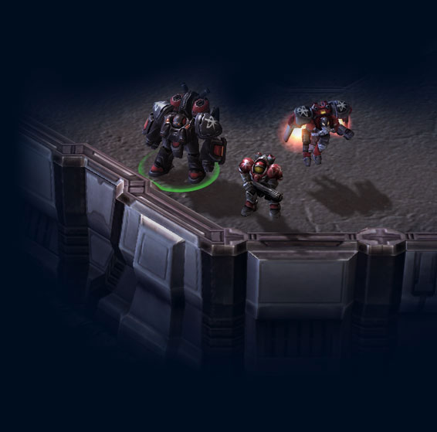
SCOUTING AND FOG OF WAR
Knowledge of what’s going on in your opponent’s base is vital to countering attacks and deploying an effective match-winning strategy. You can only see areas of the battlefield that are in your units’ line of sight, which means that you need to send units to scout. Scouting early on is important, but so is keeping up your scouting efforts as the game progresses. Workers can be effective scouts at the beginning of a game, but they are fragile and easily destroyed. If that happens, the area you were scouting will be covered by the Fog of War again and you won’t be able to see it until you move your units in again.
Most units are detected at 100% probability and 100% accuracy once they are within the Line of site (LOS) of a unit you control
Some units are invisible to all but ‘detector’ units, detection is still binary

Slide 11
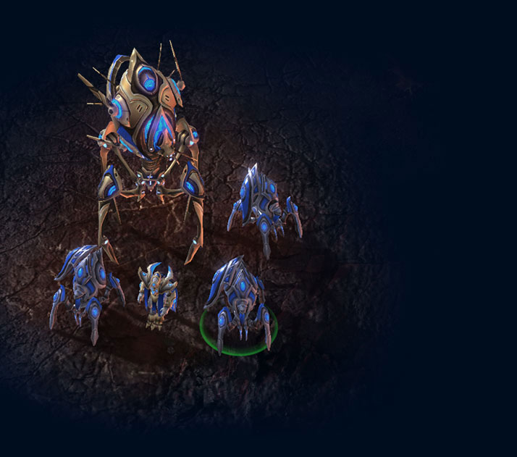



RAISING AN ARMY
Tactical finesse at the front lines is important, but you also need to keep unit production going if you want to gain the upper hand. Thankfully, each race has its own unique methods to push production capabilities to their limits.
TERRAN
Any building with an attached Reactor add-on gains a second production queue, allowing you to train twice as many units from that building. Remember that you can swap buildings by moving a currently attached building out of the way and landing another production facility in its place.
PROTOSS
The protoss can use the Nexus’s Chrono Boost ability to temporarily speed up any structure’s unit train and research rates. Once you open a Warp Gate, you can also instantly warp units into any friendly psionic matrix. This is especially useful if combined with the Phase Prism’s ability to generate a psionic matrix anywhere on the battlefield.
ZERG
The zerg are blessed with naturally high production rates, but zerg Queens can kick unit production into overdrive with their Spawn Larva ability. Targeting a Hatchery, the Queen causes the structure to spawn additional larvae. This lets you create a large number of units quickly.

Slide 12
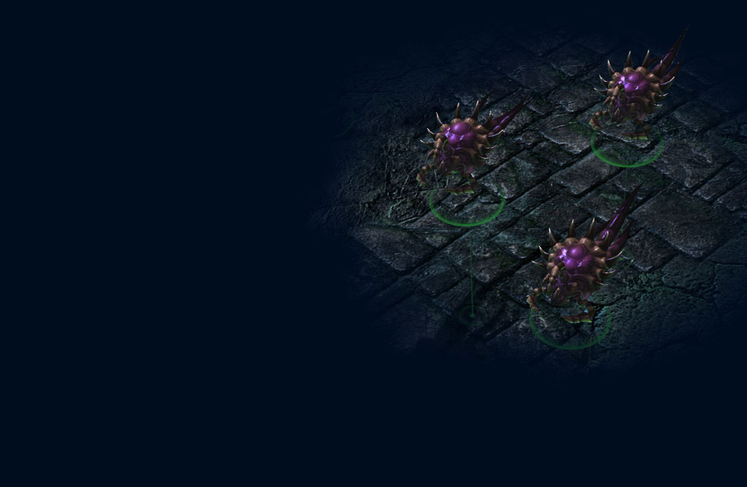
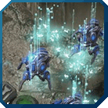

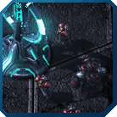
WHAT Else?
Once you’ve mastered the basics, you can begin to refine your skills as a battlefield commander by delving into the finer points of StarCraft II gameplay-overview.
SPECIAL ABILITIES
Learning how and when to use your units’ special abilities is key. As you become more familiar with the game, you’ll learn your preferred race’s unit abilities and those of the other races as well, and you will also develop a deeper understanding of each unit’s tactical significance.
STRATEGIES
In case you haven’t noticed, StarCraft II is all about strategy. Once you’ve developed a firm grasp of the game’s tactical nuances, you should check out replays of other players’ matches to learn new strategies; another excellent way to buff up on the latest strategies is to visit the StarCraft II forums and engage in discussions with other StarCraft II players.
TERRAIN
StarCraft II multiplayer maps aren’t static; they offer a wide range of strategic options you should familiarize yourself with. From Xel’naga watchtowers that lift the fog of war on strategic locations to destructible rocks that can provide a new access point to your enemy’s base, knowing how to use each map’s terrain to your advantage could make the difference.

Slide 13
What is SC2 – Do you recognize the parts?

Slide 14
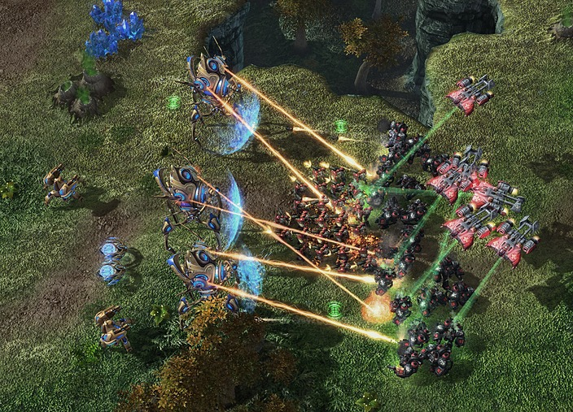
EX: Mixed Unit Combat at Choke Point

Slide 15
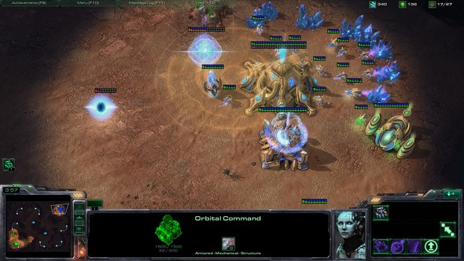
EX: Scanner Sweep

Slide 16
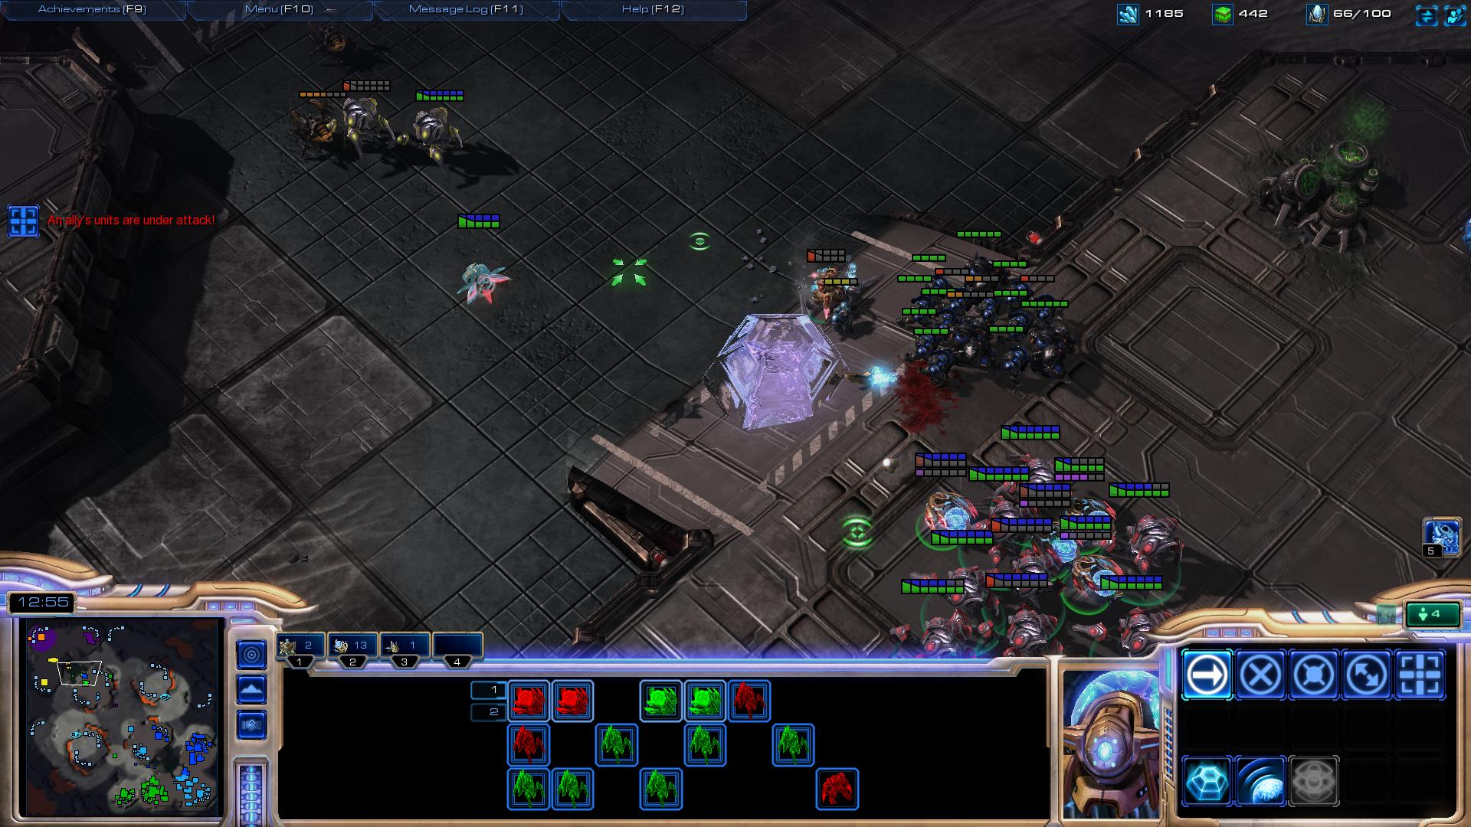
EX: Observer

Slide 17
Why SC2
Massive investment from Google’s DeepMind and Blizzard Entertainment to expose full API for AI research for free
They describe the observation, action, and reward specification for the SC2 domain;
Provide an open source Python-based interface for communicating with the game engine;
Provide a suite of mini-games focusing on different elements of SC2 gameplay;
Provide an accompanying dataset of game replay data from human expert players.
Well published, especially with Deep Reinforcement Learning (DRL) approaches
Baseline results for canonical deep reinforcement learning agents
They were able to achieve notice level performance on mini-game plays;
No significant progress on main game

Slide 18
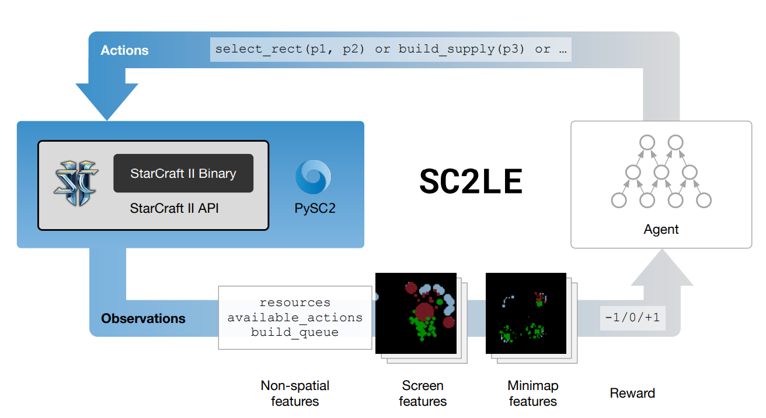
PySC2 with a neural agent

Slide 19
SC2LE
three sub-components:
a Linux StarCraft II binary
the StarCraft II API
PySC2
Can run on Windows and Mac OS, but headless build on Linus is better for distributed learning
PySC2:
defines an action and observation specification
includes a random agent and a handful of rule-based agents as examples
includes some mini-games as challenges and visualization tools to understand what the agent can see and do
StarCraft II includes a built-in AI which is based on a set of handcrafted rules and comes with 10 levels of difficulty (the three strongest of which cheat by getting extra resources or privileged vision).

Slide 20
Reward Structures
Ternary
1 (win) / 0 (tie) / −1 (loss) received at the end of a game
all-zero rewards during the game
Blizzard score
score is the score seen by players on the victory screen at the end of the game
Computed as sum of current resources and upgrades researched, as well as units and buildings currently alive and being built
Player’s cumulative reward increases with more mined resources,
Decreases when losing units/buildings,
and all other actions (training units, building buildings, and researching) do not affect it

Slide 21
Observations
Minimap and Main Screen
Actual RGB 3D slanted views hidden
Main observations come as sets of feature layers which are rendered at N × M pixels (where N and M are configurable, DeepMind just used N = M)
Views rendered as 2D images orthogonal to the camera
Each of these layers represents something specific in the game, for example: unit type, hit points, owner, or visibility
Some of these (e.g., hit points, height map) are scalars, while others (e.g., visibility, unit type, owner) are categorical
Some features (e.g., owner or visibility) exist for both the screen and minimap, while others (e.g., unit type and hit points) exist only on the screen.
Human interface for the game provides various non-spatial observations
Include the amount of gas and minerals collected, the set of actions currently available (which depends on game context, e.g., which units are selected), detailed information about selected units, build queues, and units in a transport vehicle
Audio channel not directly exposed, important notifications exposed as part of observations

Slide 22
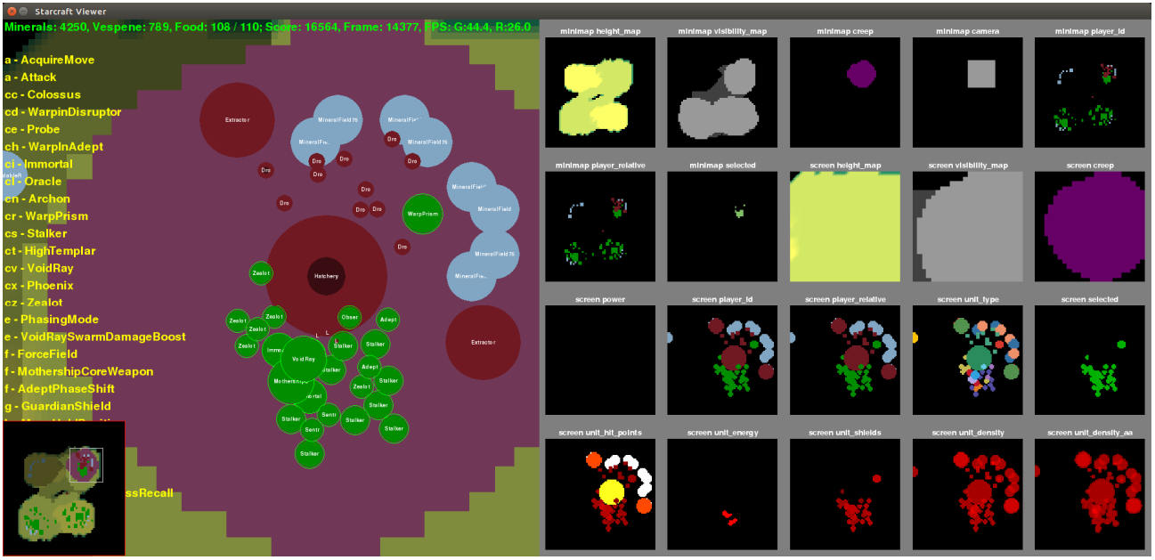
Observations
https://youtu.be/-fKUyT14G-8

Slide 23
Actions
More formally, an action a is represented as a composition of a function identifier a⁰ and a sequence of arguments which that function identifier requires: a¹ , a² , . . . , a^{L}
For instance, consider selecting multiple units by drawing a rectangle. The intended action is then select rect(select add,(x 1 , y1 ),(x 2 , y2 ))
The first argument select add is binary. The other arguments are integers that define coordinates — their allowed range is the same as the resolution of the observations
This action is fed to the environment in the form [select rect, [[select add], [x 1 , y1 ], [x 2 , y2 ]]]
Define approximately 300 action-function identifiers with 13 possible types of arguments
Human typically make between 30 and 300 actions per minute (APM), DeepMind used about 180 APM

Slide 24
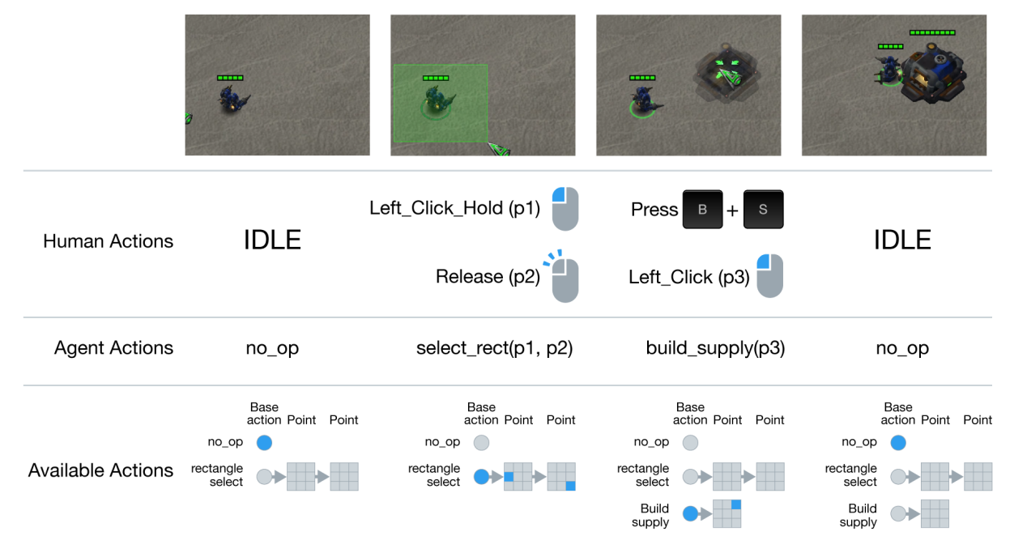
Actions

Slide 25
MiniGames
Minigames can be made with the powerful StarCraft Map Editor
The restricted action sets, custom reward functions and/or time limits are defined directly in the resulting .SC2Map file, which is easy to share
encourage users to use this method of defining new tasks, rather than customising on the agent side
The seven mini-games released with first paper:
MoveToBeacon: The agent has a single marine that gets +1 each time it reaches a beacon. This map is a unit test with a trivial greedy strategy.
CollectMineralShards: The agent starts with two marines and must select and move them to pick up mineral shards spread around the map. The more efficiently it moves the units, the higher the score.
FindAndDefeatZerglings: The agent starts with 3 marines and must explore a map to find and defeat individual Zerglings. This requires moving the camera and efficient exploration.
DefeatRoaches: The agent starts with 9 marines and must defeat 4 roaches. Every time it defeats all of the roaches it gets 5 more marines as reinforcements and 4 new roaches spawn. The reward is +10 per roach killed and −1 per marine killed. The more marines it can keep alive, the more roaches it can defeat.
DefeatZerglingsAndBanelings: The same as DefeatRoaches, except the opponent has Zerglings and Banelings, which give +5 reward each when killed. This requires a different strategy because the enemy units have different abilities.
CollectMineralsAndGas: The agent starts with a limited base and is rewarded for the total resources collected in a limited time. A successful agent must build more workers and expand to increase its resource collection rate.
BuildMarines: The agent starts with a limited base and is rewarded for building marines. It must build workers, collect resources, build Supply Depots, build Barracks, and then train marines. The action space is limited to the minimum action set needed to accomplish this goal.

Slide 26
raw API
The observations are a list of all visible units on the map along with the properties (unit type, owner, coordinates, health, etc.)
without any visual component
Fog-of-war still exists, but there is no camera, so you can see all visible units simultaneously
This is a simpler and more precise representation, but it does not correspond to how humans perceive the game. For the purposes of comparing against humans this is considered “cheating” since it offers significant additional information
Actions control units or groups of units individually by a unit identifier.
There is no need to select individuals or groups of units before issuing actions.
This allows much more precise actions than the human interface allows, and thus yields the possibility of super-human behaviour via this API.
Although they did not used any data from the raw API to train their agents, it is included in the release in order to support other use cases. PySC2 uses it for visualization while both Blizzard’s SC2 API examples and CommandCenter use it to for rule-based agents.

Slide 27
Performance
Runs faster than real time.
Observations are rendered at a speed that depends on several factors:
the map complexity,
the screen resolution,
the number of non-rendered frames per action,
and the number of threads.
For complex maps, computation is dominated by simulation speed,
higher resolution does not hurt,
running more stances in parallel threads scales quite well
With a resolution of 64 × 64 and acting at a rate of 8 frames per action, the single-threaded speed of a ladder map varies from 200–700 game steps per wall-clock second, which is more than an order of magnitude faster than real-time.
For simpler maps, world simulation is quick, so rendering the observations dominates.
In this case increasing the frames per action and decreasing the resolution can have a large effect.
The bottleneck then becomes the Python interpreter, negating gains above roughly 4 threads with a single interpreter

Slide 28
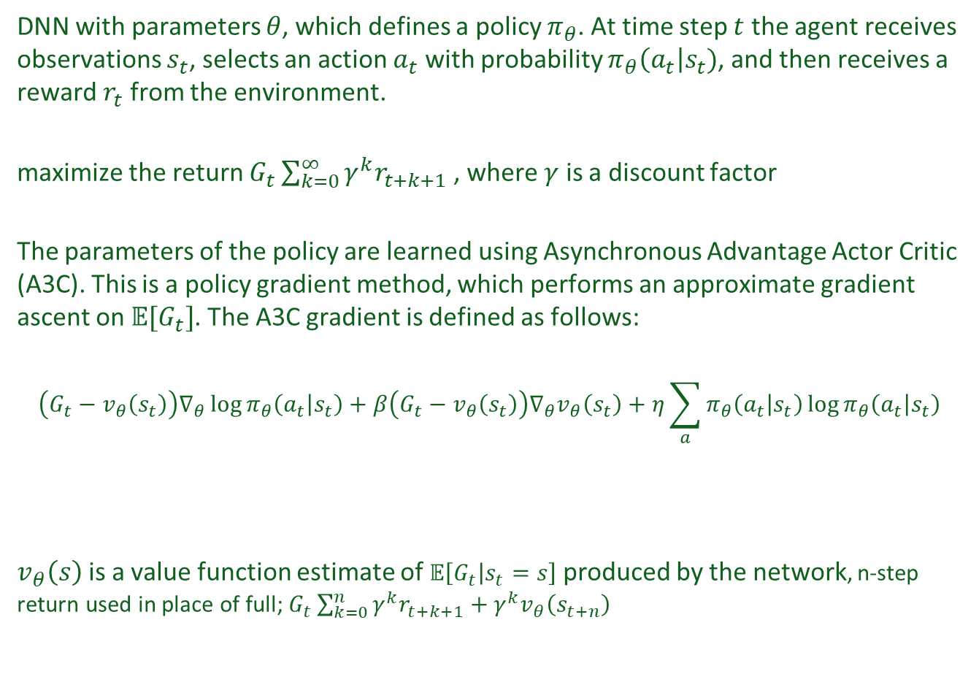
Reinforcement Learning: Baseline Agents
DNN with parameters $θ$, which defines a policy $π_{θ}$. At time step $t$ the agent receives observations $s_{t}$, selects an action $a_{t}$ with probability $π_{θ}\left(a_{t}\right|s_{t})$, and then receives a reward $r_{t}$ from the environment.
maximize the return $G_{t}\sum_{k=0}^{∞}{γ^{k}r_{t+k+1}}$ , where $γ$ is a discount factor
The parameters of the policy are learned using Asynchronous Advantage Actor Critic (A3C). This is a policy gradient method, which performs an approximate gradient ascent on $𝔼[G_{t}]$. The A3C gradient is defined as follows:
$$\left(G_{t}−v_{θ}\left(s_{t}\right)\right)∇_{θ}\log{π_{θ}\left(a_{t} | s_{t}\right)}+β\left(G_{t}−v_{θ}\left(s_{t}\right)\right)∇_{θ}v_{θ}\left(s_{t}\right)+η\sum_{a}{π_{θ}\left(a_{t} | s_{t}\right)\log{π_{θ}\left(a_{t} | s_{t}\right)}}$$
$v_{θ}\left(s\right)$is a value function estimate of $𝔼\left[G_{t} | s_{t}=s\right]$ produced by the network, n-step return used in place of full; $G_{t}\sum_{k=0}^{n}{γ^{k}r_{t+k+1}+γ^{k}v_{θ}\left(s_{t+n}\right)}$
policy gradient
value estimation gradient
entropy regularization

Slide 29
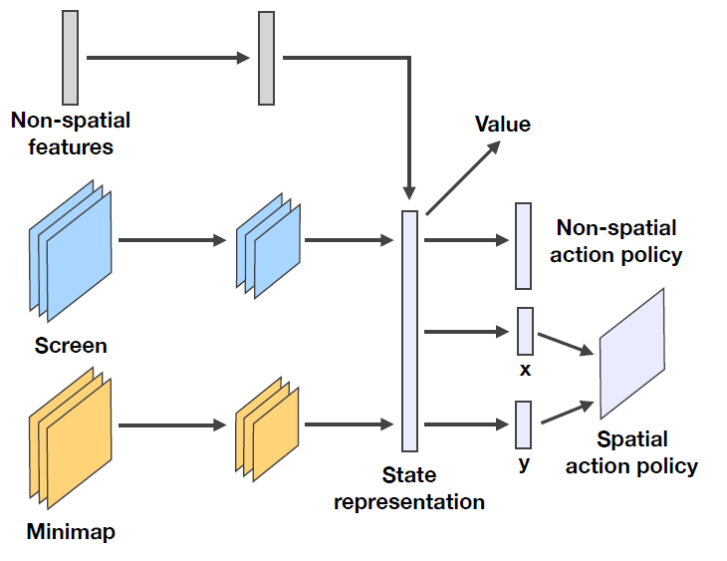
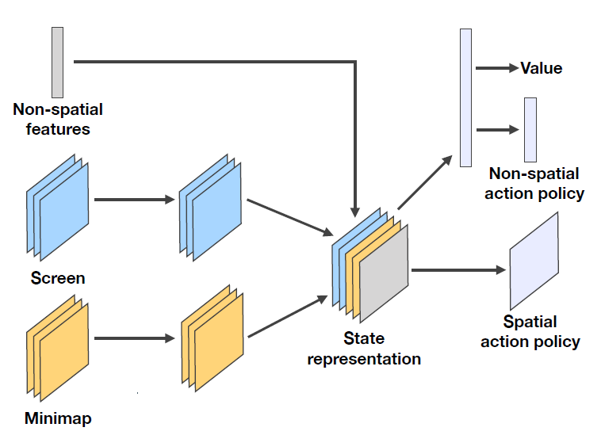
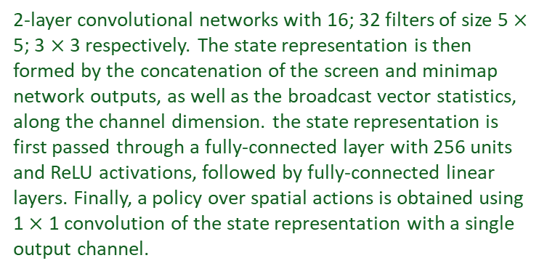
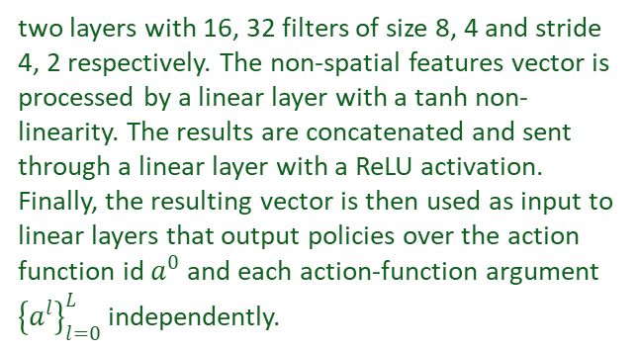
Network architectures
Network architectures of the basic agents considered in the paper.
(a) Atari-net
(b) FullyConv
two layers with 16, 32 filters of size 8, 4 and stride 4, 2 respectively. The non-spatial features vector is processed by a linear layer with a tanh non-linearity. The results are concatenated and sent through a linear layer with a ReLU activation. Finally, the resulting vector is then used as input to linear layers that output policies over the action function id $a^{0}$ and each action-function argument ${\left\{a^{l}\right\}}_{l=0}^{L}$ independently.
2-layer convolutional networks with 16; 32 filters of size 5 $×$ 5; 3 $×$ 3 respectively. The state representation is then formed by the concatenation of the screen and minimap network outputs, as well as the broadcast vector statistics, along the channel dimension. the state representation is first passed through a fully-connected layer with 256 units and ReLU activations, followed by fully-connected linear layers. Finally, a policy over spatial actions is obtained using 1 $×$ 1 convolution of the state representation with a single output channel.

Slide 30
Other Network architectures
FullyConv LSTM Agent: Both of the above baselines are feed-forward architectures and therefore have no memory. While this is sufficient for some tasks, we cannot expect it to be enough for the full complexity of StarCraft. Here we introduce a baseline architecture based on a convolutional LSTM. We follow the fully-convolutional agent’s pipeline described above and simply add a convolutional LSTM module after the minimap and screen feature channels are concatenated with the non-spatial features.
Random agents: We use two random baselines. Random policy is an agent that picks uniformly at random among all valid actions, which highlights the difficulty of stumbling onto a successful episode in a very large action space. The random search baseline works by taking many independent, randomly initialised policy networks (with a low softmax temperature that induces near deterministic actions), evaluating each for 20 episodes and keeping the one with the highest mean score. This is complementary in that it samples in policy space rather than action space.

Slide 31
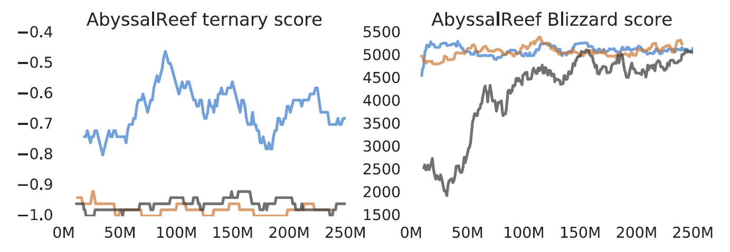
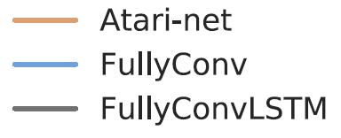
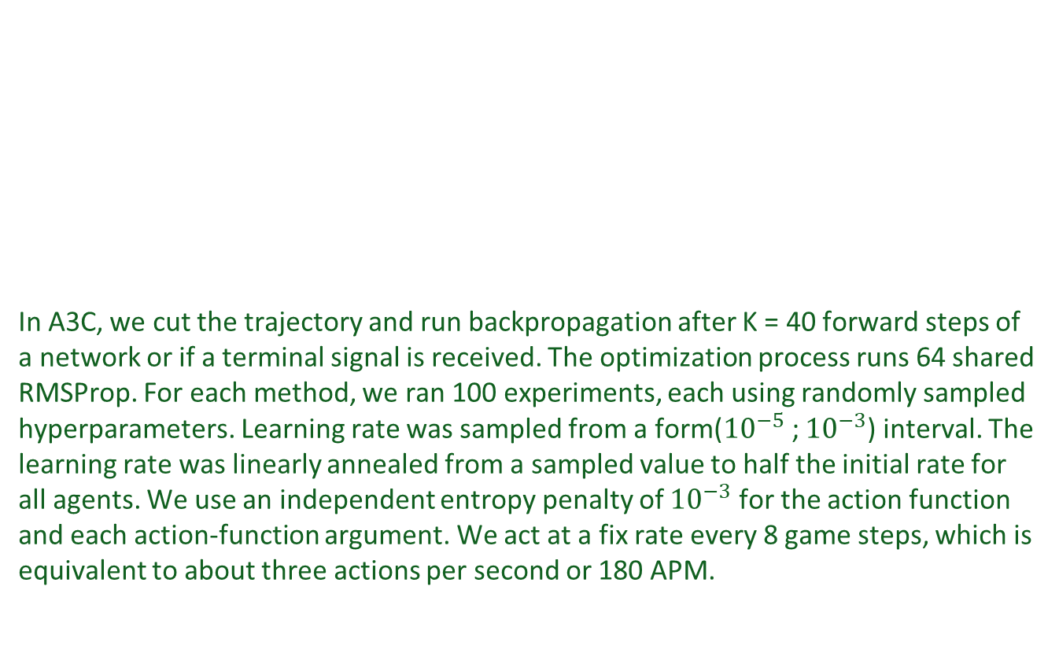
Results
In A3C, we cut the trajectory and run backpropagation after K = 40 forward steps of a network or if a terminal signal is received. The optimization process runs 64 shared RMSProp. For each method, we ran 100 experiments, each using randomly sampled hyperparameters. Learning rate was sampled from a form(${10}^{−5}$; ${10}^{−3}$) interval. The learning rate was linearly annealed from a sampled value to half the initial rate for all agents. We use an independent entropy penalty of ${10}^{−3}$ for the action function and each action-function argument. We act at a fix rate every 8 game steps, which is equivalent to about three actions per second or 180 APM.

Slide 32
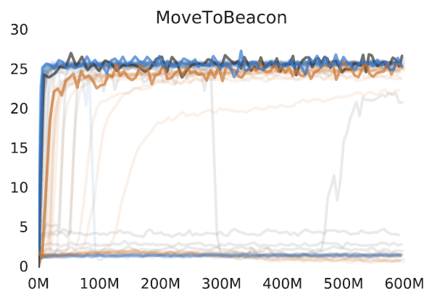
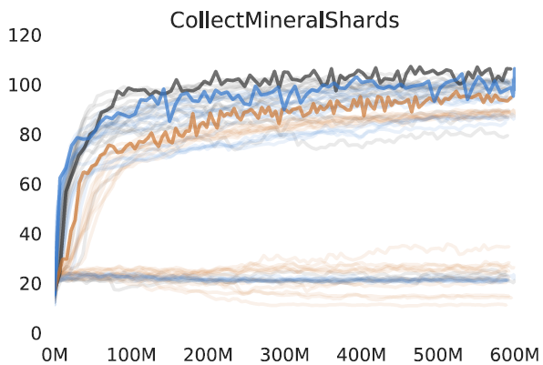
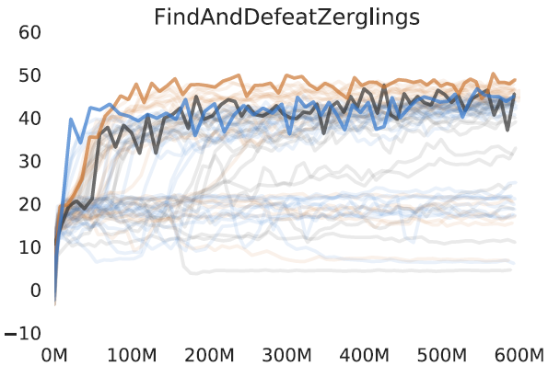
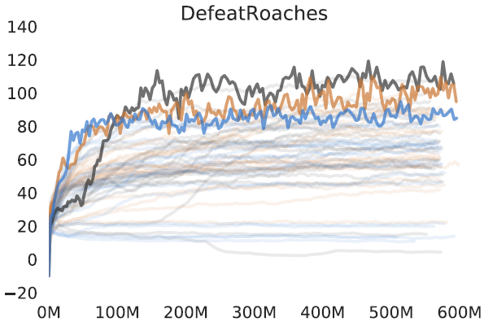
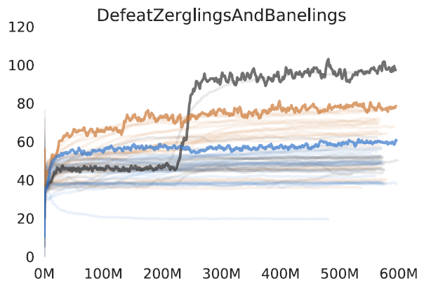
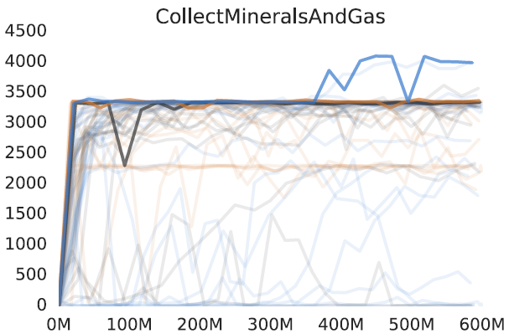
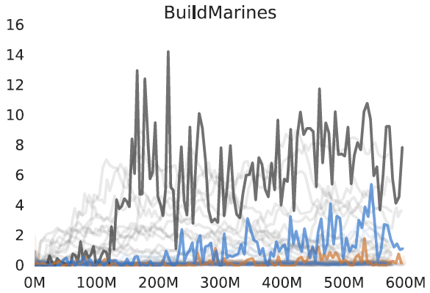
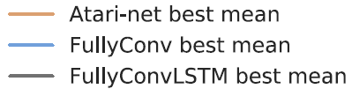
Results – Mini Games
Note: The faint lines show all 100 runs with different hyper-parameters, the solid line is the run with the best mean. Lines are smoothed for improved visibility.
Notes:
and Random Search, while Atari-Net failed to learn a strategy to consistently produce marines at
each episode. It should be noted that, without the restrictions on action space imposed by this map,
it would actually be much harder to learn on this mini-game.
All agents performed sub-optimally when compared against the GrandMaster player, except for the
simplest MoveToBeacon, which only requires good mechanics and reaction—what artificial agents
are expected to be good at. However, in some games like DefeatRoaches and FindAndDefeatZerglings,
our agents fared well versus the DeepMind game tester.
The results of our baseline agents demonstrate that even relatively simple mini-games present interesting
challenges, which we hope will inspire new research.

Slide 33
Links
StarCraft II Overview:
http://us.battle.net/sc2/en/game/guide/gameplay-overview
StarCraft II API:
https://github.com/Blizzard/s2client-proto
PySC2:
https://github.com/deepmind/pysc2
DeepMind’s First Paper on SC2LE:
https://arxiv.org/pdf/1708.04782.pdf
Presentation given at Big Data Spain:
https://www.youtube.com/watch?v=Xq_8WTiWb2M

Slide 34

Questions?

